Slide 1
Unified Modeling Language (UML)

Slide 2
Unified Modeling Language
Unified Modeling Language (UML) is a standardized general-purpose modeling language in the field of software engineering.
designed to provide a standard way to visualize the design of a system.
The standard is managed, and was created by, the Object Management Group.
Rumbaugh, Booch, and Jacobson with input from others, formalized the UML standard (UML 1.1) in 1997.
Revised in 2003 (UML 1.5): Currently most widely used.
Reorganized in 2005 (UML 2.0): A new standard.
UML 2.5 was released in June2015.

Slide 3
Unified Modeling Language (UML)
UML includes a set of graphic notation techniques to create visual models of software-intensive systems.
A visual modelling language to
Visualize, construct, document software system.
Similar to all other languages, UML has:
Grammar: Rules to follow when drawing diagrams.
Semantics: The meaning behind each diagram.
Used with the Object-Oriented Method.
Separates the language from the software process → can be used with other software development model.
ISO standard - Currently, this is an industry standard.
OO Modeling approach with different strengths and weaknesses grows rapidly.

Slide 4
What UML is NOT
Not a programming language.
Not executable.
Exist tools to translate into code (skeleton), but the programmer still need to do the bulk of work.
Not a software modeling tool.
Not a SE method or software development process.

Slide 5
UML: View Models
A system can be viewed in different ways, usually depends on the role of the viewer.
UML supports this by providing the 4 + 1 View Models [Kruchten, 1995]:
System
Design View
Implementation View
Use Case View
Deployment View
Process View

Slide 6
overview
UML offers a way to visualize a system's architectural blueprints in a diagram including elements such as
Activities
Individual components of the system
how they can interact with other software components.
How entities interact with others (components and interfaces)
External user interface

Slide 7
Structure Diagrams
Structure diagrams emphasize the things that must be present in the system being modeled. Since structure diagrams represent the structure they are used extensively in documenting the architecture of software systems.
Class diagram: describes the structure of a system by showing the system's classes, their attributes, and the relationships among the classes.
Component diagram: describes how a software system is split up into components and shows the dependencies among these components.

Slide 8
Structure Diagrams
Deployment diagram: describes the hardware used in system implementations and the execution environments and artifacts deployed on the hardware.
Object diagram: shows a complete or partial view of the structure of a modeled system at a specific time.
Package diagram: describes how a system is split up into logical groupings by showing the dependencies among these groupings.

Slide 9
Behavior Diagrams
Behavior diagrams emphasize what must happen in the system being modeled. Since behavior diagrams illustrate the behavior of a system, they are used extensively to describe the functionality of software systems.
Activity diagram: describes the business and operational step-by-step workflows of components in a system. An activity diagram shows the overall flow of control.
UML state machine diagram: describes the states and state transitions of the system.
Use case diagram: describes the functionality provided by a system in terms of actors, their goals represented as use cases, and any dependencies among those use cases.

Slide 10
Interaction Diagrams
Interaction diagrams, a subset of behaviour diagrams, emphasize the flow of control and data among the things in the system being modeled:
Sequence diagram: shows how objects communicate with each other in terms of a sequence of messages. Also indicates the lifespans of objects relative to those messages.
Timing diagrams: are a specific type of interaction diagram, where the focus is on timing constraints.
Communication diagram: shows the interactions between objects or parts in terms of sequenced messages. They represent a combination of information taken from Class, Sequence, and Use Case Diagrams describing both the static structure and dynamic behavior of a system.
Interaction overview diagram: provides an overview in which the nodes represent interaction diagrams.

Slide 11
Class Diagrams
The main building block in object oriented modeling
They are used both for general conceptual modeling of the systematics of the application, and for detailed modeling translating the models into programming code
The classes in a diagram represent both the main objects and/or interactions in the application and the objects to be programmed
In the diagram these classes are represented with boxes which contain three parts

Slide 12
Class Diagrams
A class with three sections.
The upper part holds the name of the class
The middle part contains the attributes of the class
The bottom part gives the methods or operations the class can take or undertake

Slide 13
Class Diagrams
In the system design of a system, a number of classes are identified and grouped together in a class diagram which helps to determine the static relations between those objects
With detailed modeling, the classes of the conceptual design are often split in a number of subclasses
In order to further describe the behavior of systems, these diagrams can be complemented by state diagram or UML state machine
Also instead of class diagrams, Object role modeling can be used if you just want to model the classes and their relationships

Slide 14
Classes
A class is a description of a set of
objects that share the same attributes,
operations, relationships, and semantics.
Graphically, a class is rendered as a
rectangle, usually including its name,
attributes, and operations in separate,
designated compartments.
ClassName
attributes
operations

Slide 15
Class Names
ClassName
The name of the class is the only required tag in the graphical representation of a class. It always appears in the top-most compartment.
attributes
operations

Slide 16
Class Attributes
Person
name : String
address : Address
birthdate : Date
ssn : Id
An attribute is a named property of a
class that describes the object being modeled.
In the class diagram, attributes appear in
the second compartment just below the
name-compartment.

Slide 17
Class Attributes (Cont’d)
Attributes are usually listed in the form:
attributeName : Type
A derived attribute is one that can be
computed from other attributes, but
doesn’t actually exist. For example,
a Person’s age can be computed from
his birth date. A derived attribute is
designated by a preceding ‘/’ as in:
/ age : Date
Person
name : String
address : Address
birthdate : Date
/ age : Date
ssn : Id

Slide 18
Class Attributes (Cont’d)
Person
+ name : String
# address : Address
# birthdate : Date
/ age : Date
- ssn : Id
Attributes can be:
+ public
# protected
- private
/ derived

Slide 19
Class Operations
Person
name : String
address : Address
birthdate : Date
ssn : Id
eat
sleep
work
play
Operations describe the class behavior
and appear in the third compartment.

Slide 20
Class Operations (Cont’d)
PhoneBook
newEntry (n : Name, a : Address, p : PhoneNumber, d : Description)
getPhone ( n : Name, a : Address) : PhoneNumber
You can specify an operation by stating its signature: listing the name, type, and default value of all parameters, and, in the case of functions, a return type.

Slide 21
Depicting Classes
When drawing a class, you needn’t show attributes and operation in every diagram.
Person
Person
Person
name : String
birthdate : Date
ssn : Id
Person
name
address
birthdate
eat()
sleep()
work()
play()
Person
eat
play

Slide 22
Class Responsibilities
A class may also include its responsibilities in a class diagram.
A responsibility is a contract or obligation of a class to perform a particular service.
SmokeAlarm
Responsibilities
-- sound alert and notify guard station
when smoke is detected.
-- indicate battery state

Slide 23
Relationships
In UML, object interconnections (logical or physical), are
modeled as relationships.
There are three kinds of relationships in UML:
dependencies
generalizations
associations

Slide 24
Dependency Relationships
A dependency indicates a semantic relationship between two or
more elements. The dependency from CourseSchedule to Course exists because Course is used in both the add and remove operations of CourseSchedule.
CourseSchedule
Course
add(c : Course)
remove(c : Course)

Slide 25
Generalization Relationships
Person
A generalization connects a subclass
to its superclass. It denotes an
inheritance of attributes and behavior
from the superclass to the subclass and
indicates a specialization in the subclass
of the more general superclass.
Student

Slide 26
Generalization Relationships (Cont’d)
UML permits a class to inherit from multiple superclasses, although some programming languages (e.g., Java) do not permit multiple inheritance.
Student
Employee
TeachingAssistant

Slide 27
Association Relationships
If two classes in a model need to communicate with each other, there must be link between them.
An association denotes that link.
Student
Instructor

Slide 28
Association Relationships (Cont’d)
We can indicate the multiplicity of an association by adding multiplicity adornments to the line denoting the association.
The example indicates that a Student has one or more Instructors:
Student
Instructor
1..*

Slide 29
Association Relationships (Cont’d)
The example indicates that every Instructor has one or more Students:
Student
Instructor
1..*

Slide 30
Association Relationships (Cont’d)
We can also indicate the behavior of an object in an association (i.e., the role of an object) using rolenames.
teaches
learns from
Student
Instructor
1..*
1..*

Slide 31
Association Relationships (Cont’d)
We can also name the association.
membership
Student
Team
1..*
1..*

Slide 32
Association Relationships (Cont’d)
We can specify dual associations.
member of
Student
Team
1..*
1..*
1
president of
1..*

Slide 33
Association Relationships (Cont’d)
We can constrain the association relationship by defining the navigability of the association. Here, a Router object requests services from a DNS object by sending messages to (invoking the operations of) the server. The direction of the association indicates that the server has no knowledge of the Router.
Router
DomainNameServer

Slide 34
Association Relationships (Cont’d)
Associations can also be objects themselves, called link classes or an association classes.
Registration
modelNumber
serialNumber
warrentyCode
Product
Warranty

Slide 35
Association Relationships (Cont’d)
A class can have a self association.
next
LinkedListNode
previous

Slide 36
Association Relationships (Cont’d)
We can model objects that contain other objects by way of special associations called aggregations and compositions.
An aggregation specifies a whole-part relationship between an aggregate (a whole) and a constituent part, where the part can exist independently from the aggregate. Aggregations are denoted by a hollow-diamond adornment on the association.
Car
Engine
Transmission

Slide 37
Association Relationships (Cont’d)
A composition indicates a strong ownership and coincident lifetime of parts by the whole (i.e., they live and die as a whole). Compositions are denoted by a filled-diamond adornment on the association.
Window
Scrollbar
1
1
Titlebar
1
1
Menu
1
1 .. *

Slide 38
Interfaces
An interface is a named set of operations that specifies the behavior of objects without showing their inner structure. It can be rendered in the model by a one- or two-compartment rectangle, with the stereotype <<interface>> above the interface name.
<<interface>>
ControlPanel

Slide 39
Interface Services
<<interface>>
ControlPanel
Interfaces do not get instantiated. They have no attributes or state. Rather, they specify the services offered by a related class.
getChoices : Choice[]
makeChoice (c : Choice)
getSelection : Selection

Slide 40
Interface Realization Relationship
<<interface>>
ControlPanel
A realization relationship connects a class with an interface that supplies its behavioral specification. It is rendered by a dashed line with a hollow triangle towards the specifier.
specifier
implementation
VendingMachine

Slide 41
Enumeration
<<enumeration>>
Boolean
An enumeration is a user-defined data type that consists of a name and an ordered list of enumeration literals.
false
true

Slide 42
Exceptions
<<exception>> Exception
Exceptions can be modeled just like any other class.
Notice the <<exception>> stereotype in the name compartment.
getMessage()
printStackTrace()
<<exception>> KeyException
<<exception>> SQLException

Slide 43
Packages
A package is a container-like element for organizing other elements into groups.
A package can contain classes and other packages and diagrams.
Packages can be used to provide controlled access between classes in different packages.
Compiler

Slide 44
Packages (Cont’d)
Compiler
We can model generalizations and dependencies between packages.
JavaCompiler
Java

Slide 45
Component Diagram
Component diagrams are one of the two kinds of diagrams found in modeling the physical aspects of an object-oriented system.
They show the organization and dependencies between a set of components.
This involves modeling the physical things that reside on a node, such as executable, libraries, tables, files, and documents.
a collection of diagrams are used to represent the whole design.
To visualize the implementation details.

Slide 46
So before drawing a component diagram the following artifacts are to be identified clearly:
Files used in the system.
Libraries and other artifacts relevant to the application.
Relationships among the artifacts.
Now after identifying the artifacts the following points needs to be followed:
Use a meaningful name to identify the component for which the diagram is to be drawn.
Prepare a mental layout before producing using tools.
Use notes for clarifying important points.

Slide 47
Component Diagram
signal.h
signal.h
signal.h
version = 3.5
version = 4.0
version = 4.1
“parent”
“parent”
signal.cpp
interp.cpp
version = 4.1
Modeling source code.
[Booch, 99]
irq.h
device.cpp

Slide 48
Deployment Diagram
Deployment diagrams are one of the two kinds of diagrams found in modeling the physical aspects of an object-oriented system.
They show the configuration of run-time processing nodes and the components that live on them.
Use deployment diagrams to model the static deployment view of a system. This involves modeling the topology of the hardware on which the system executes.

Slide 49
Deployment Diagram
A component is a physical unit of implementation with well-defined interfaces that is intended to be used as a replaceable part of a system.
Well designed components do not depend directly on other components, but rather on interfaces that components support.
component
spell-check
Dictionary
interfaces
synonyms

Slide 50
Deployment Diagram
stereotyped
<<database>>
component
Account
Transactions
Update
interface
usage dependency
component
ATM-GUI
realization dependency
[Rumbaugh,99]

Slide 51
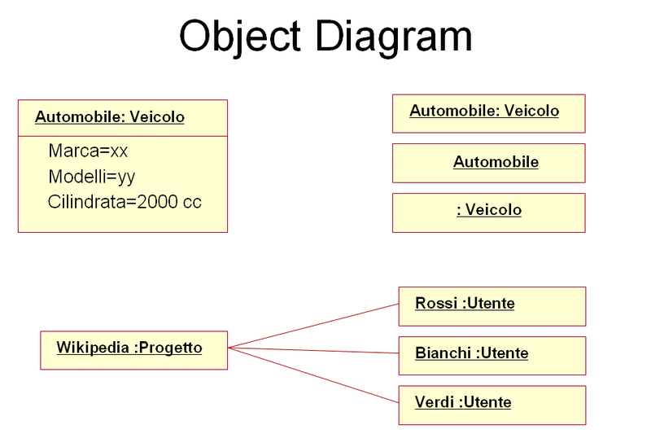
Object Diagram
A diagram that shows a complete or partial view of the structure of a modeled system at a specific time
Focuses on some particular set of object instances and attributes, and the links between the instances

Slide 52
Object Diagram
A set of objects (instances of classes) and their relationships
A link is shown as a solid line, and represents an instance of an association
A static snapshot of a dynamic view of the system
Represents real or prototypical cases

Slide 53
Instance Specifications
Each object and link is represented by an Instance Specification
This can show an object's classifier (e.g. an abstract or concrete class) and instance name, as well as attributes and other structural features using slots
Each slot corresponds to a single attribute or feature, and may include a value for that entity
The name on an instance specification optionally shows …
an instance name, a ':' separator, and optionally one or more classifier names separated by commas
The contents of slots, if any, are included below the names, in a separate attribute compartment

Slide 54
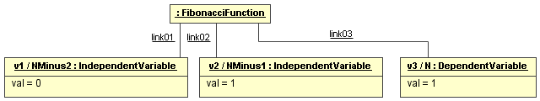
Example
As an example, consider one possible way of modeling production of the Fibonacci sequence

Slide 55
Example
In the first UML object diagram, the instance in the leftmost instance specification …
is named v1,
has IndependentVariable as its classifier,
plays the NMinus2 role within the FibonacciSystem, and
has a slot for the val attribute with a value of 0

Slide 56
Example
The topmost instance, an anonymous instance specification, …
has FibonacciFunction as its classifier, and
may have an instance name, a role, and slots, but these are not shown here

Slide 57
Example
The diagram also includes three named links, shown as lines
Links are instances of an association

Slide 58
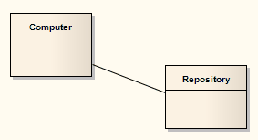
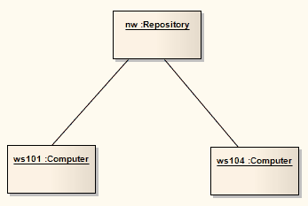
More Examples
Object diagram
Class diagram

Slide 59
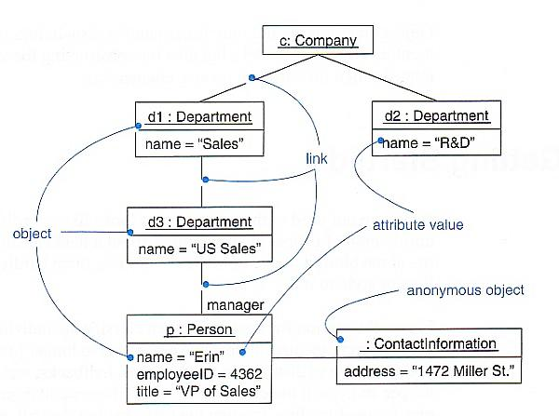
More Examples
What does this object diagram tell us?

Slide 60
Use Case
“A use case specifies the behavior of a system or a part of a system,
is a description of a set of sequences of actions,
including variants, that a system performs to yield an observable result of value to an actor.”
- The UML User Guide, [Booch,99]
“An actor is an idealization of an external person, process, or thing interacting with a system, subsystem, or class.
An actor characterizes the interactions that outside users may have with the system.”
- The UML Reference Manual, [Rumbaugh,99]

Slide 61
Use Case (Cont’d)
Register for Courses
A use case is rendered as an ellipse in a use case diagram. A use case is always labeled with its name.

Slide 62
Use Case (Cont’d)
An actor is rendered as a stick figure in a use case diagram. Each actor participates in one or more use cases.
Student

Slide 63
Use Case (Cont’d)
Actors can participate in a generalization relation with other actors.
Student
Person

Slide 64
Use Case (Cont’d)
Actors may be connected to use cases
only by associations.
Register for Courses
Student

Slide 65
Use Case (Cont’d)
Here we have a Student interacting with the Registrar and the
Billing System via a “Register for Courses” use case.
Billing System
Student
Register for Courses
Registrar

Slide 66
State Machine
“The state machine view describes the dynamic behavior of objects over time by modeling the lifecycles of objects of each class.
Each object is treated as an isolated entity that communicates with the rest of the world by detecting events and responding to them. Events represent the kinds of changes that objects can detect... Anything that can affect an object can be characterized as an event.”
- The UML Reference Manual, [Rumbaugh,99]

Slide 67
State Machine
An object must be in some specific state at any given time during its lifecycle. An object transitions from one state to another as the result of some event that affects it. You may create a state diagram for any class, collaboration, operation, or use case in a UML model .
There can be only one start state in a state diagram, but there may be many intermediate and final states.

Slide 68
State Machine
start state
final state
simple state
concurrent composite state
sequential composite state

Slide 69
State Machine
download course offerings
downloading
unscheduled
make a course selection
selecting
make a different selection
verify selection
verifying
select another course
check schedule
sign schedule
checking schedule
scheduled

Slide 70
Sequence Diagram
A sequence diagram is an interaction diagram that emphasizes the time ordering of messages. It shows a set of objects and the messages sent and received by those objects.
Graphically, a sequence diagram is a table that shows objects arranged along the X axis and messages, ordered in increasing time, along the Y axis.
- The UML User Guide, [Booch,99]

Slide 71
Sequence Diagram
an Order Line
An object in a sequence diagram is rendered
as a box with a dashed line descending from it.
The line is called the object lifeline, and it
represents the existence of an object over a
period of time.

Slide 72
Sequence Diagram
an Order Line
a Stock Item
Messages are rendered as horizontal
arrows being passed from object to
object as time advances down the
object lifelines. Conditions ( such as
[check = “true”] ) indicate when a
message gets passed.
check()
[check = “true”] remove()

Slide 73
Sequence Diagram
an Order Line
a Stock Item
check()
Notice that the bottom arrow is different. The arrow head is not solid, and there is no accompanying message.
This arrow indicates a return from a previous message, not a new message.
[check = “true”] remove()

Slide 74
Sequence Diagram
an Order
a Order Line
* prepare()
An iteration marker, such as * (as shown), or *[i = 1..n] , indicates that a message will be repeated as indicated.
Iteration
marker

Slide 75
an Order Entry window
an Order
an Order Line
a Stock Item
[Fowler,97]
prepare()
Condition
* prepare()
Object
check()
Message
[check = “true”] remove()
needsToReorder()
Iteration
Return
Self-Delegation
[needsToReorder = “true”]
new
A Reorder Item
[check = “true”] new
A Delivery Item
Creation

Slide 76
Collaboration Diagram
A collaboration diagram emphasizes the relationship of the objects that participate in an interaction. Unlike a sequence diagram, you don’t have to show the lifeline of an object explicitly in a collaboration diagram. The sequence of events are indicated by sequence numbers preceding messages.
Object identifiers are of the form objectName : className, and either the objectName or the className can be omitted, and the placement of the colon indicates either an objectName: , or a :className.

Slide 77
Collaboration Diagram
: Order Entry Window
Object
Sequence Number
1: prepare()
Message
: Order
Self-Delegation
5: needToReorder()
2*: prepare()
3: check()
4: [check == true] remove()
: Order Line
: Stock Item
7: [check == true] new
6: new
:Delivery Item
:Reorder Item
[Fowler,97]

Slide 78
Activity Diagram
An activity diagram is essentially a flowchart, showing the flow of control from activity to activity.
Use activity diagrams to specify, construct, and document the dynamics of a society of objects, or to model the flow of control of an operation. Whereas interaction diagrams emphasize the flow of control from object to object, activity diagrams emphasize the flow of control from activity to activity. An activity is an ongoing non-atomic execution within a state machine.
- The UML User Guide, [Booch,99]

Slide 79
Receive
[Fowler,97]
Order
Multiple Trigger
*
for each line
item on order
Cancel
Authorize
Check
Order
Payment
Line
[failed]
Item
[succeeded]
[in stock]
Assign to
Order
Synchronization Condition
[need to
reorder]
Reorder
[stock assigned to
Item
all line items and
payment authorized]
Dispatch
Order

Slide 80
References
[Booch99] Booch, Grady, James Rumbaugh, Ivar Jacobson,
The Unified Modeling Language User Guide, Addison Wesley, 1999
[Rambaugh99] Rumbaugh, James, Ivar Jacobson, Grady Booch, The Unified
Modeling Language Reference Manual, Addison Wesley, 1999
[Jacobson99] Jacobson, Ivar, Grady Booch, James Rumbaugh, The Unified
Software Development Process, Addison Wesley, 1999
[Fowler, 1997] Fowler, Martin, Kendall Scott, UML Distilled
(Applying the Standard Object Modeling Language),
Addison Wesley, 1997.
[Brown99] First draft of these slides were created by James Brown.

